Slide 1
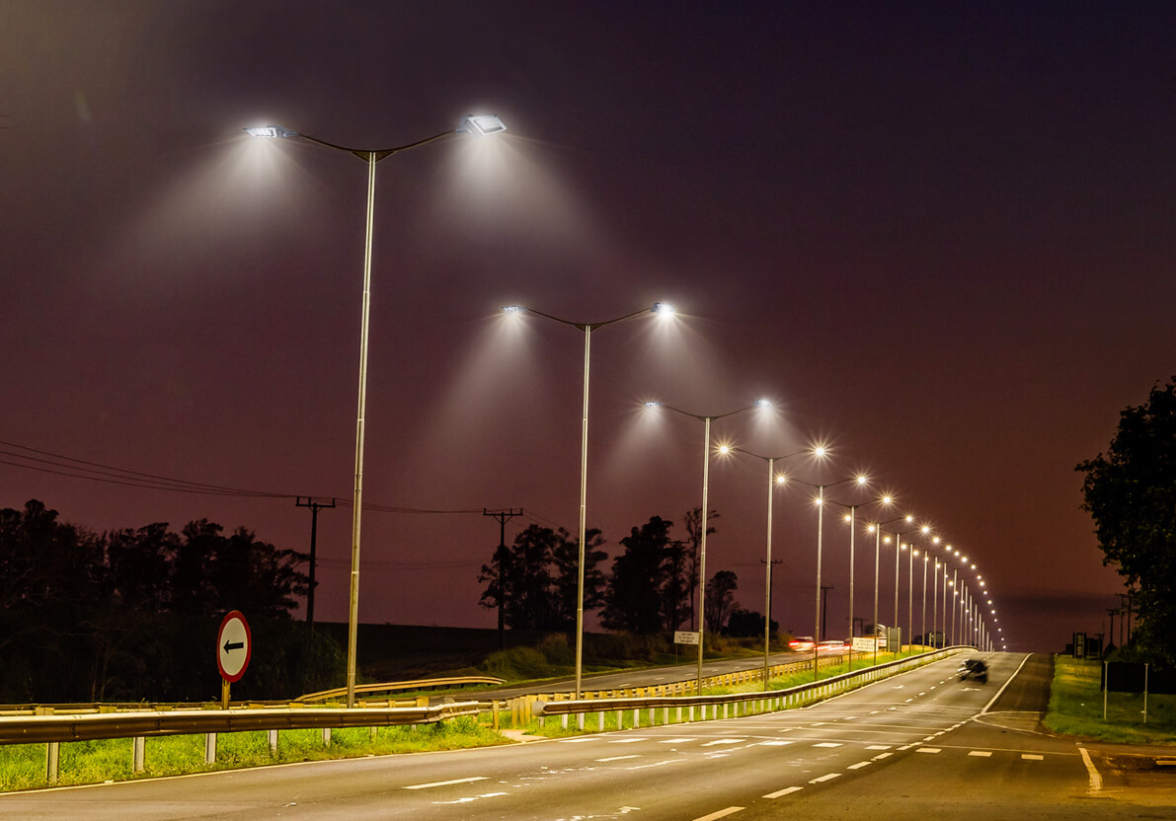
Smart Citylighting
Team Luminaries: Group 1
Atanu Kar Ashee Jain
Deepak Mathur Anjali Manoj
Srujana Sabbani
No of Slides: 12
Time: 10 Mins

Slide 2
CONTENTS
Background and Motivation
Previous Works
Key Technology and Project Design
Work Flow Diagram
Benefits & Trade-Offs
Results and Summary
Demo

Slide 3
Background and Motivation
Waste of Electricity on NHs and SHs - Need a smart solution
Many research works are focused on implementing smart citylights
Implementation: Each and every electricity pole is turned to act as a smart lightpost
Use of low power technologies such as Zigbee and BLE
Drawbacks of existing solutions
High implementation cost - More no of Microcontrollers & Sensors
Network design and implementation is complex
Maintenance of WSN is costly and need constant effort
Very less communication range : Therefore no of sensor node increases
We need a cost effective solution for Smart Citylights

Slide 4
Previous Work and techniques used in smart streetlighting
H C Lee at el. :[3] A low-cost and noninvasive system for the measurement and detection of faulty streetlights
This involves physical petrolling of entire area by a car with LDR and GPS mounted in order to locate faulty lightposts.
P. Karthikeyan at el. :[4] Design and Implementation of Smart Street Light Automation and Fault Detection System
Involves use of LDR in order to detect the fault and GPS module to get the exact location.
S. Sophiya Susan at el. :[9] Vehicle Movement based Innovative Smart Highway Lighting System
Involves use of PIR sensor to detect vehicle movement and passes info to gateway in case any fault is detected.
A. Abdullah at el. :[10] Smart Street Light Using Intensity Controller
Involves use of LDR to control intensity of light as per presence of sunlight and PIR sensor detects vehicle movement. Does not focus on fault detection.
C. -W. Yang at el. :[1] Vehicle and pedestrian aware street lighting automation
This paper involves detecting the presence of vehicle in a cell (a small area of road) also puts a constraint on vehicle speed. If both condition is satisfied then lights are turned on.
Nefedov, Evgeny, et al. "Energy efficient traffic-based street lighting automation.":[2]
This paper also involves control of street lights based on the fact the vehicle is present in a particular area.
Jabbar, HN Jasim ZN Kamal SF. "SMART COMMUNITY WITH CREATE A MANAGEMENT SYSTEM FOR STREET LIGHTS.“:[5]
This involves IR sensor for movement detection and lights are controlled as per LDR input.
Fanoon, A. R. F. S., and A. R. F. Shafana. "Smart lighting system for efficient street lighting.":[6]
In this paper LED control and fault detection is based on LDR input.
Gagliardi, Gianfranco, et al. "Advanced adaptive street lighting systems for smart cities." :[7]
This paper involves Zigbee based communication between sensor node to pass the info between Node to Node and uses cellular network to transfer the info to base stn or servers.
Dwijaksara, Made Harta, Wha Sook Jeon, and Dong Geun Jeong. "Multihop gateway-to-gateway communication protocol for lora networks.":[8]
This paper shows the concept of multihop communication gateway to gateway communication using LoRa.

Slide 5
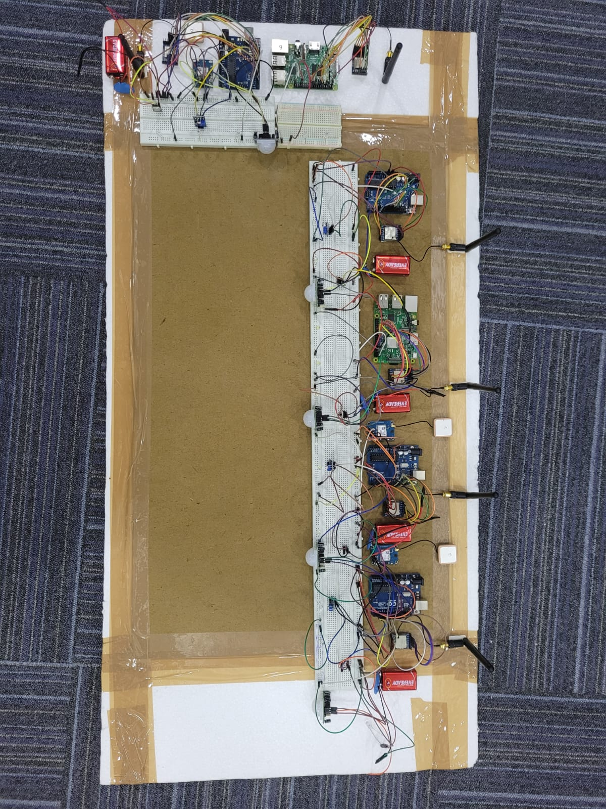
Key Technology and Project Design
WSN Communication
LoRaWAN with sensor nodes based on Arduino UNO and Raspberry Pi
Few sensor nodes based on Raspberry Pi are earmarked as Gateway
Node to Node, Node to Gateway and Gateway to Gateway communication using LoRa over 433 MHz freq
Server/Admin to Gateway communication using Ethernet connectivity available in the city.
Two Tier architecture:
Sensor Node to Gateway
Gateway to Server
Hardware Modules Involved
Motion Detection : PIR sensor HCSR 501
Fault Detection : LDR Sensor LM393
Location : GPS Module GY-NE06MV2
LoRa Module : LoRa Ra-02 SX1278 433MHz
Dev Board : Arduino UNO and Raspberry Pi 3 B
Voltage Regulator : IC LM7805

Slide 6

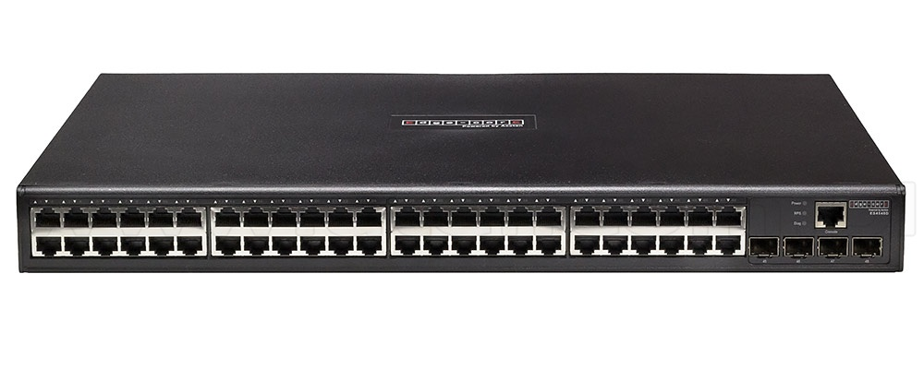
Work Flow Diagram
Server Location
Admin
Internet Connectivity over Ethernet (Available in the City)
GPS
LoRa
Gw SN
Sends Location(GPS) info and Fault with Node ID over LoRa
LDR
PIR
SN + G
SN GW
Sends Location(GPS) info and Fault with Node ID over LoRa
SN SN
Sends over LoRa if vehicle detected by PIR Sensor
GPS
LoRa
GPS
LoRa
GPS
LoRa
LDR
PIR
SN SN
Sends over LoRa to next neighbouring Node if vehicle detected by PIR Sensor
LDR
PIR
LDR
PIR
SN
SN + G
SN

Slide 7
Modules of the Project
Node to Node Communication (Arduino UNO to Arduino UNO) movement detection and controlling of streetlights
Node to Gateway Communication (Arduino UNO to Raspberry Pi) movement detection and controlling of streetlights
Node to Gateway Communication (Arduino UNO to Raspberry Pi) in case of fault detected by LDR. Sends location Information and light status info to gateway.
Gateway to Gateway Communication for fault tolerence as well as multipath routing.
IoT Security
Secure login using login credentials for Gateway .
Network Segmentation using Firewall and monitoring of end device status. using Nagios or similar monitoring software
IP and MAC binding of Gateways

Slide 8
Benefits & Trade-Offs
What differences our project will make for the environment ?
What are the advantages of this project against other available projects?
Cost effective solution : No of sensor nodes are less as compare to other solutions available as they put sensor nodes in each and every streetlight on the road.
We overcome the limitation of short range communication such as Zigbee and BLE used by other solutions by using LoRa.
Maintenance is easy and faster as no of sensor node/Gw location is less.
Deployable with existing lighting system unlike other solutions which replaces the existing lights with smart lights.
Fault repair by repair team needs manual checking in an area of 500-600m.
Needs additional cabling between a group of streetlights for parallel connection.
Fault in one node will lead to non functioning of multiple streetlights.

Slide 9
Results and Summary
We have achieved the project functionality as desired.
The output of different modules were tested successfully.
Summary:
This concept would motivate everyone to use in the city/Highways as it has multiple benefits given earlier.
Reuse of Existing system is also a factor of attracting people for using this concept.
Constraints for demo
In order to build LoRa gateway we need LoRa concentrator or LoRa hat which supports multi channel Tx/Rx on a freq band with FH.
Due to demo at a small space and LoRa working on 433 MHz signal interference is more leading collision of data packets.
GPS signal is not available at indoor environment however the same has been successfully tested at a open space.
Modules
Node to Node Communication over LoRa for the functionality of streetlights.
Node to Gw communication for fault detection and passing of location information.
Gw to Gw communication to achieve fault tolerence.
Demo of each module will be shown separately.

Slide 10
Contribution
40%
40%
20%
Atanu Kar
&
Ashee Jain
Deepak Mathur
&
Srujana Sabbani
Anjali Manoj
LoRa Communication Gw to Gw
(Raspberry Pi to Raspberry Pi)
LoRa Communication SN to Gw
(Arduino to Raspberry Pi)
Hardware Integration and Preparation of presentation
LoRa Communication
(Arduino UNO to Arduino UNO)
PIR and LDR sensor integration with Arduino UNO and Raspberry Pi
Hardware Integration and report preparation
Integration of GPS Module with Arduino UNO
Hardware Integration and report preparation

Slide 11
Demo
Node to Node Communication
Arduino UNO to Arduino UNO
Arduino UNO to Raspberry Pi (Sensor Info)
Node to Gw Communication
Arduino UNO to Raspberry Pi
(Fault detection and Location info)
Gw to Gw Communication
Raspberry Pi to Raspberry Pi
GPS Info from Node to Gw

Slide 12

Q &A

Slide 13

Thank You
Team: Luminaries

